Slide 1
IMD312: REFERENCE AND INFORMATION SERVICES FOR INFORMATION AGENCIES
Topic 12: Reference Librarian
Notes:
IMD307

Slide 2
LIBRARIAN
Significant Points
A master's degree in library science is required for most librarian positions
Librarian positions focus on one of three aspects of library work: user services, technical services, and administrative services
Librarians use the latest information technology to perform research, classify materials, and help students and library patrons seek information.

Slide 3
Nature of Work
Librarians, often called Information Professionals, combine traditional duties with tasks involving quickly changing technology.
Librarians help people find information and use it effectively for personal and professional purposes.
- knowledge of a wide variety of scholarly and public information sources
- follow trends related to publishing, computers, and the media to oversee the selection and organization of library materials.

Slide 4
Nature of Work
Librarians manage staff and develop and direct information programs and systems for the public and ensure that information is organized in a manner that meets users' needs.

Slide 5
Nature of work
Librarians in user services, such as reference and children's librarians, work with users to help them find the information they need.
The job involves:
- analyzing users' needs to determine what information is appropriate and searching for
- acquiring, and providing the information.

Slide 6
Nature of work
- instructional role, such as showing users how to find and evaluate information.
E.g. librarians help users navigate the Internet so they can search for and evaluate information efficiently.

Slide 7




Slide 8
Nature of Work
Librarians also recommend materials, analyze collections and compile lists of books, periodicals, articles, audiovisual materials, and electronic resources on particular subjects.
Librarians coordinate programs such as storytelling for children and literacy skills and book talks for adults, conduct classes, publicize services, write grants, and oversee other administrative matters.

Slide 9
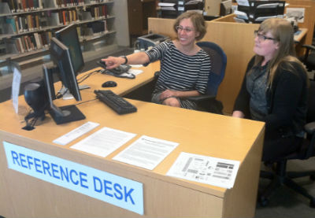
Nature of Work
Librarians develop and index databases and help train users to develop searching skills.
Librarians must know how to use electronic resources and inform the public about the wealth of information they contain.

Slide 10
Work environment
Librarians spend a significant portion of time at their desks or in front of computer terminals;
assisting users in obtaining information or books for their jobs, homework, or recreational reading.

Slide 11

Work environment
Some librarians lift and carry books, and some climb ladders to reach high stacks, although most modern libraries have readily accessible stacks.
Librarians in small settings without support staff sometimes shelve books themselves.

Slide 12

REFERENCE LIBRARIANS ARE A LIBRARY’S EYES AND EARS

Slide 13
REFERENCE LIBRARIAN
SUCCESSFUL REFERENCE LIBRARIANS NEED:
1. Subject area knowledge
2. Conversational skills
3. Competence in selecting and acquiring materials

Slide 14
ROLES OF LIBRARIAN
1. Informational provider advisor intermediary evaluator | 2. Educational teacher educator instructor
Notes:
IMD307

Slide 15
A reference librarian needs all the qualities of a good detective;
Curiosity,
Thoroughness,
Perseverance,
Accuracy.
Notes:
perseverance. : continued effort to do or achieve something despite difficulties, failure, or opposition : the action or condition or an instance of persevering : steadfastness.
IMD307

Slide 16
To be able to execute the best job…reference librarian also needs…..
patience, kindness, compassion, courtesy and helpfulness.

Slide 17
Characteristics of a Good Reference Librarian
Confident to relate the sources to answers
Good memory
Appreciation of reference sources
Ability to sort and reword a jumbled query
Calm attitude / confidence
Sense of humor
Dedication / commitment
Genuine liking for people
Imaginative and creative
Notes:
IMD307

Slide 18
Characteristics of a Good Reference Librarian
Patience and persistence
Energy and stamina
Ability to jump quickly from one subject to another
Empathetic behavior
Be approachable
Show interest
Notes:
IMD307
-proper empathic engagement helps one to understand and anticipate the behavior of another

Slide 19
CODES OF ETHICS
Remain objective
Provide the right information
Avoid making judgments' about the clients or the questions asked
Avoid interpreting the information
Avoid giving legal, medical or financial advice
Respect the confidentiality of each query
Provide equal service to all
Remember legal implications when supplying information
Notes:
IMD307
8. (e.g. copyright, freedom of information, privacy, censorship, confidentiality

Slide 20
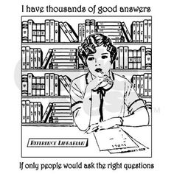

Slide 21
THAT’S ALL FOR TODAY
THANK YOU

